Slide 1
CHAPTER 8 STRATEGIC MANAGEMENT

Slide 2
Lecture summary
The concept of strategic management
Role of competitive analysis in strategy formulation
Formulating corporate level strategy
Formulating business level strategy
Formulating functional level strategy
Strategy implementation

Slide 3
Concept of strategic management
‘Large-scale action plan for interacting with the environment to achieve long-term goals.’

Slide 4
Concept of strategic management
Strategic management process
Importance of strategic management
Levels of strategy

Slide 5
Concept of strategic management
Strategic management process:
‘Process through which managers formulate and implement strategies geared to optimising strategic goal achievement, given available environmental and internal conditions.’

Slide 6
Concept of strategic management
Strategic management process:
Strategy formulation
Identify mission & goals
Competitive situation analysis (external & internal)
Develop/formulate strategies to achieve identified goals
Strategy implementation
Implement plans
Control/monitor execution of plans

Slide 7
Strategic management process
Environmental
analysis
Formulate
mission &
strategic goals
Conduct SWOT
analysis
Strategy
formulation
Strategy
implementation
Strategic
control
Internal (organisational)
assessment

Slide 8
Importance of strategic management
Important because:
Helps organisations develop a competitive advantage (significant edge over competition in dealing with competitive forces).
Provides a sense of long-term direction for organisation members.
Highlights need for innovation.
Process involves members and fosters understanding of goals/strategy.

Slide 9
Importance of strategic management
Competitive advantage
Direction for
the organisation
Supports innovation
Builds manager
commitment

Slide 10
Levels of strategy
Corporate level
Business level
Functional level

Slide 11
Levels of strategy
Corporate level strategy:
‘Type of strategy addressing what businesses the organisation will operate, how strategies of those businesses will be co-ordinated to strengthen the organisation’s competitive position, and how resources will be allocated among businesses.’

Slide 12
Levels of strategy
Business level strategy:
‘Type of strategy concentrating on the best means of competing within a particular business while also supporting corporate level strategy.’

Slide 13
Levels of strategy
Functional level strategy:
‘Type of strategy focussing on action plans for managing a particular functional area within a business in a way that supports business level strategy.’

Slide 14
Competitive analysis in strategy formulation
Before managers devise an effective strategy
for getting a competitive edge, they must
analyse the organisation’s competitive
situation.
This is done through:
Environmental analysis (external)
Organisational assessment (internal)

Slide 15
Environmental assessment
Competitor Analysis
Industry & Market Analysis
Political & Regulatory Analysis
The organisation
Social Analysis
Economic Analysis
Human Resources Analysis

Slide 16
Competitive analysis in strategy formulation
SWOT analysis:
Method of analysing an organisation’s competitive situation involving assessing organisational strengths (S), weaknesses (W), environmental opportunities (O) and threats (T).

Slide 17
Competitive analysis in strategy formulation
Environmental assessment:
Five competitive forces model (Porter):
Rivalry
Bargaining power of customers
Bargaining power of suppliers
Threat of new entrants
Threat of substitute products/services.

Slide 18
Competitive analysis in strategy formulation
Organisational assessment:
Value Do the firm’s resources & capabilities add value by enabling it to exploit opportunities or neutralise threats?
Rareness How many competing firms already possess these valuable resources & capabilities?
Imitability Do firms without a resource or capability face a cost disadvantage?
Organisation Is the firm organised to exploit competitive potential of its resources & capabilities?

Slide 19
Formulating corporate level strategy
Corporate level strategy is the overall strategy
an organisation follows. Its development
involves selecting a grand strategy and using
portfolio-strategy approaches to determine the
various businesses making up the organisation:
Grand strategy
Portfolio-strategy approaches.

Slide 20
Formulating corporate level strategy
Grand Strategies
Growth
Concentration
Market development
Product development
Horizontal integration
Vertical Integration
Stability
Harvest
Defensive
Diversification
Turnaround
Divestiture
Bankruptcy
Liquidation

Slide 21
Formulating corporate level strategy
Portfolio strategies:
Method of analysing an organisation’s mix of businesses in terms of both individual and collective contributions to strategic goals.
BCG growth–share matrix
Compares businesses in an organisation’s portfolio on the basis of relative market market share and market growth rate.

Slide 22
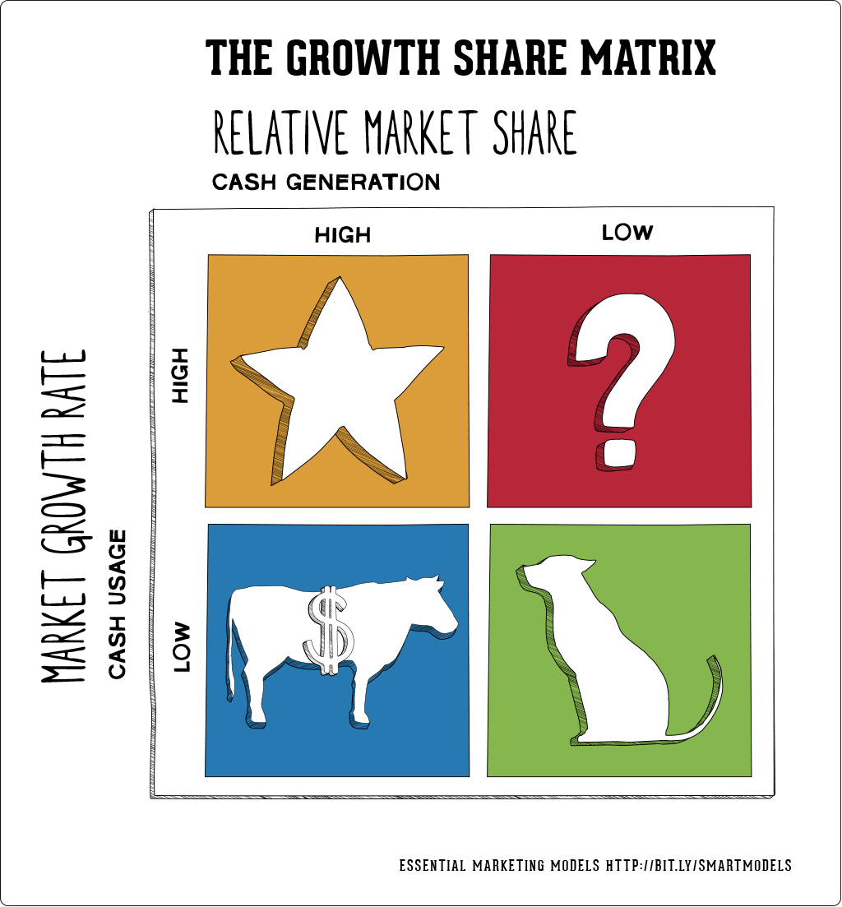
BCG growth-share matrix
Relative competitive position

Slide 23
Dogs. Dogs hold low market share compared to competitors and operate in a slowly growing market.
Strategic choices: Retranchement, divestiture, liquidation
Cash cows. Cash cows are the most profitable brands and should be “milked” to provide as much cash as possible. The cash gained from “cows” should be invested into stars to support their further growth.
Strategic choices: Product development, diversification, divestiture, retrenchment
Stars. Stars operate in high growth industries and maintain high market share. Stars are both cash generators and cash users.
Strategic choices: Vertical integration, horizontal integration, market penetration, market development, product development

Slide 24
Question marks. Question marks are the brands that require much closer consideration. They hold low market share in fast growing markets consuming large amount of cash and incurring losses.
Strategic choices: Market penetration, market development, product development, divestiture

Slide 25
Formulating business level strategy
Business level strategy is concerned with how a particular business competes.
The best known approach for strategy development is based on Porter’s research.

Slide 26
Formulating business level strategy
Generic business strategies:
Porter outlined three generic business level strategies to gain competitive advantage over other firms operating in the same industry.

Slide 27
Formulating business level strategy
Generic business strategies (Porter):
Cost leadership strategy
Emphasises operational efficiency i.e. overall costs are lower than competitors.
Differentiation strategy
Attempts to develop products/services viewed as unique in the industry.
Focus strategy
Concentration on a segment, portion of a market.

Slide 29
Formulating functional level strategy
Functional level strategies spell out specific
ways that functional areas can bolster business
level strategy.
For example:
Under a product differentiation strategy, the R & D dept. may accelerate the innovation process to provide new products in advance of competitors.

Slide 30
Strategy implementation
Strategy implementation involves management activities needed to put the strategy in motion, institute strategic controls for monitoring progress, and ultimately achieve organisation goals.

Slide 31
Strategy implementation
Carry out plans:
Technology
Human resources
Reward systems
Decision processes
structure
Maintain control:
Control systems
Adjustments
Strategy
formulation

Slide 32
Lecture summary
Concept of strategic management
Process
Importance
Levels
Competitive analysis in strategy formulation
SWOT analysis
Environmental assessment
Organisational assessment

Slide 33
Lecture summary
Formulating corporate level strategy
Grand strategy
Portfolio strategies
Formulating business level strategy
Porter generic strategies: cost, differentiation & focus
Formulating corporate level strategy
Strategy implementation
Control systems & adjustments

